Slide 1
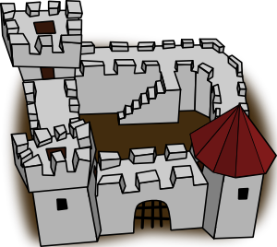
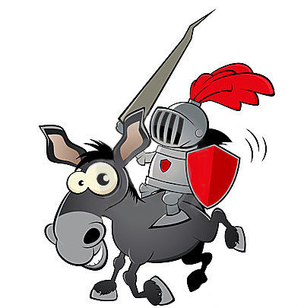
Medieval Knights
…becoming a knight

Slide 2
Page
When a nobleman’s son was about seven years of age, he would be sent to the castle of another knight to learn how to become a knight.
He would act as a page for the lord or, possibly, another knight
Most boys were a page for about 6 or 7 years learning the skills of knighthood.
https://www.youtube.com/watch?v=yO28lnjtsQc

Slide 3
Squire
If a page had done well, at about fourteen or fifteen years of age he would become a squire.
His training would become more serious as he would be expected to aid his knight in battle.
He would learn how to spring, fully armed, onto a horse and how to use a sword, mace and lance in battle.

Slide 4
Knight
A squire would usually become a knight at about the age of twenty. He would have either proved himself in battle or his lord would have decided that he was ready.
A squire would be dubbed a knight after an elaborate ceremony.
He would then begin to purify himself through prayer and fasting for a day and a night.

Slide 5
Knight
He would then confess his sins to a priest, bathe, and dress in a white tunic which signified his purity.
Over the tunic he would wear a red robe to show his willingness to shed blood for God and for his lord.
His shoes and hose, or tights, were black, symbolising death.

Slide 6
Chivalry
He would attend a church service called a mass, have his sword and shield blessed and vow,
“to defend the weak, the orphan, the widow, and that women should receive his special care”
The rules of chivalry also included being courteous, loyal and honouring.
He would also swear allegiance to his lord, who would knight the squire by dubbing or patting him on each shoulder with the flat side of his sword.

Slide 7
Heraldry
When knights were fully dressed in their armour, it was difficult to tell a friend from a foe on the battle field.
https://www.youtube.com/watch?v=sEuhKRhrvRM
The knight’s shield was decorated with a coat of arms that was his unique identity.
Only 5 colours and 2 metals could be used and there were many rules governing design, shape, pattern and symbols.

Slide 8
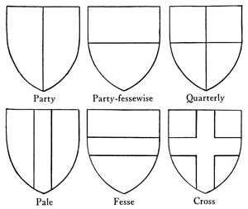
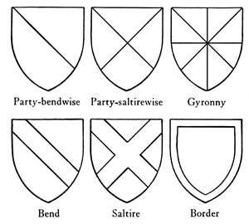
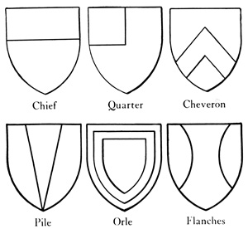
Examples:

